Slide 1
Automated Nano-Optical Measurements
Spandan Anaokar
210260055
Supervisor:
Prof. Anshuman Kumar

Slide 2
1.
MOTIVATION
Need for Automation

Slide 3
Purpose: Why do we need Automation?
PL Spectroscopy analyzes sample by exciting the particles and then reading the emitted photons data
Problem: Limited area analyzed. Manually doing for large region is costly
Solution: Automate the procedure. Just input in the requirements and automatically PL is done at each point.
ADD PHOTO OF BAND GAP

Slide 4
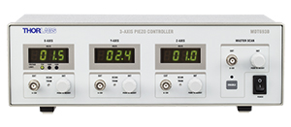
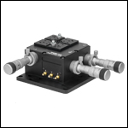
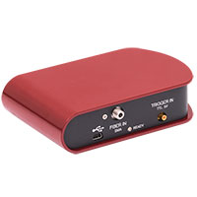
Goals: How do we do Automation?
We thus have two sets of instruments
Spectrometer: read data
Stage: Change location being read
In the project we use Thorlabs CCS 175 and Thorlabs Nanomax 300.
First write individual codes for the instruments
Second Combine them to do our work
Nanomax Stage Controller
Nanomax Stage
CCS Spectrometer

Slide 5
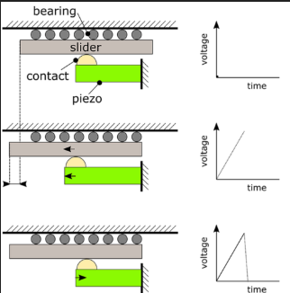
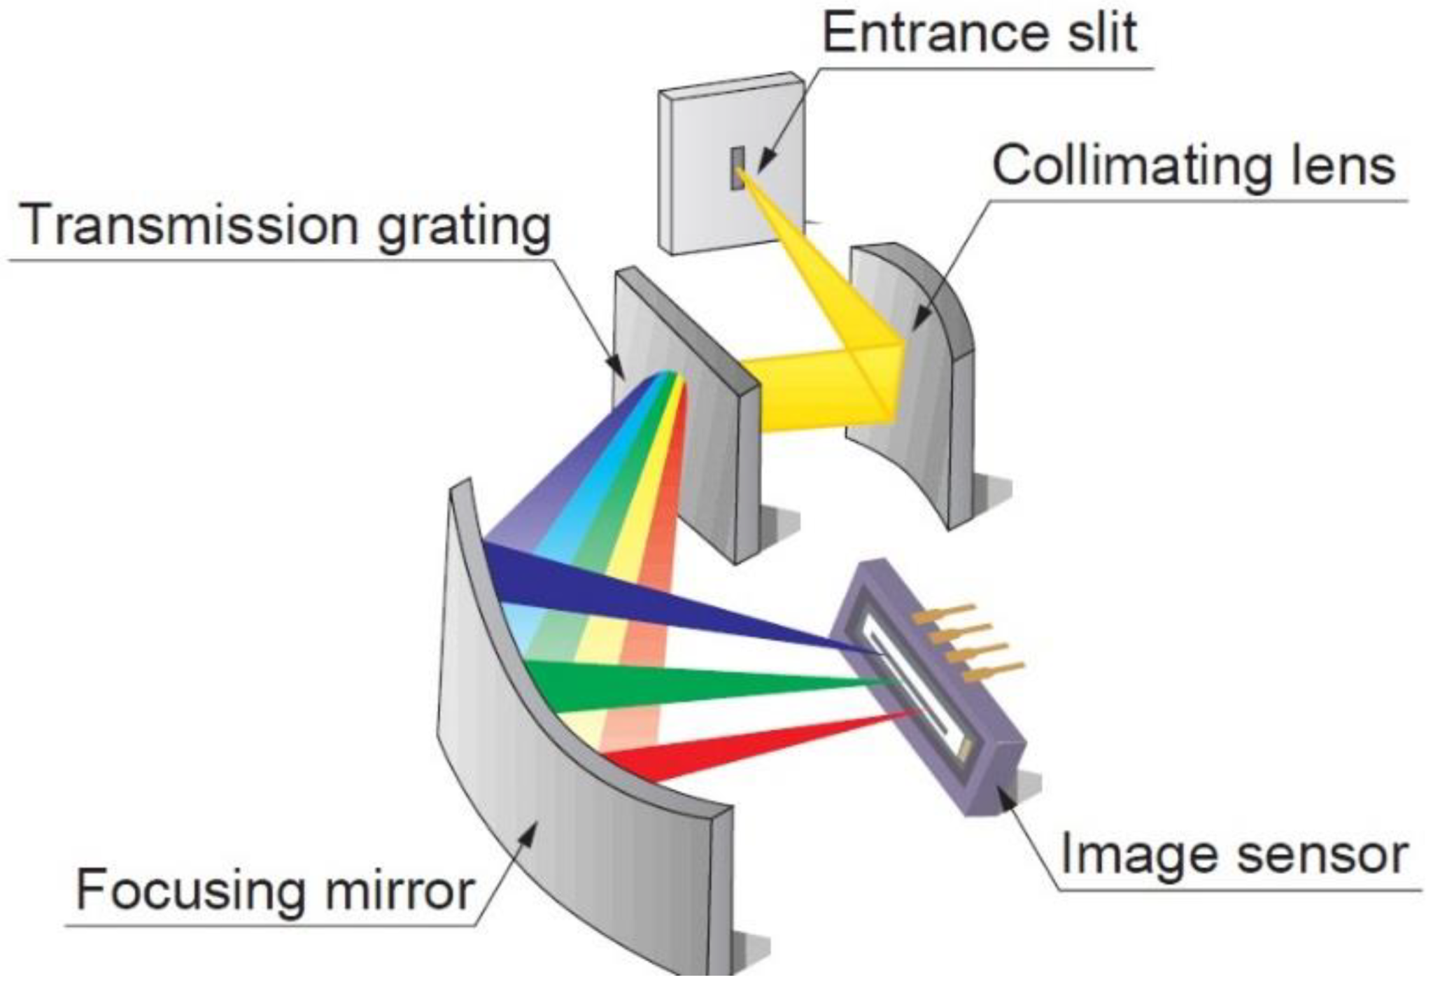
Thorlabs CCS
Nanomax
CCD(charge coupled device): Spatially resolve light
Detection Range: 500-1000nm
Grating: 830 lines/mm
Integration Time: 10µs-10s
Max Scan rate: 200/s
Trigger Signal: TTL
Trigger Input: SMB
USB2.0 (480Mbit/s)
Piezoelectric stage: use electricity to cause motion
Drive voltage range: 0-75V
Resolution: 5nm
Max velocity: 5 mm/s
Resonant Frequency: 375 Hz
Theremal Stability: 1µm/K
Fine Adjustment: 50 µm/rev
Micrometers do general adjustment. Piezomotor does precise adjustment
Notes:
SMB: Sub-miniature version B
dsin()=m(lambda)

Slide 6
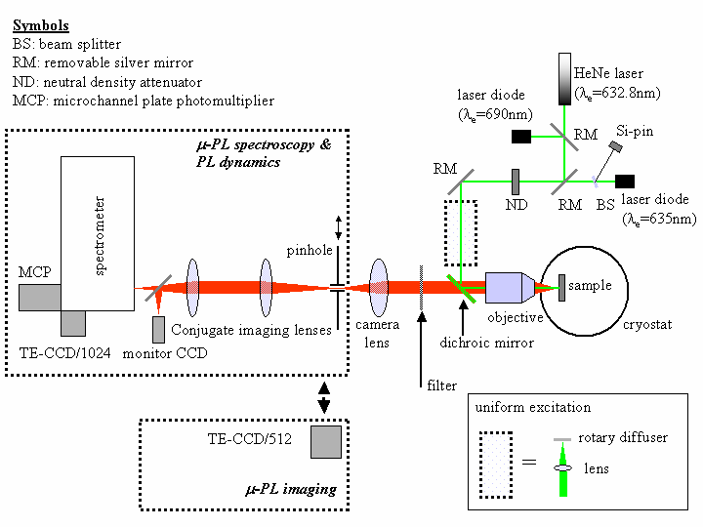
Experiment Setup: The final apparatus
stage

Slide 7
2.
Phase I:
Development of CCS

Slide 8
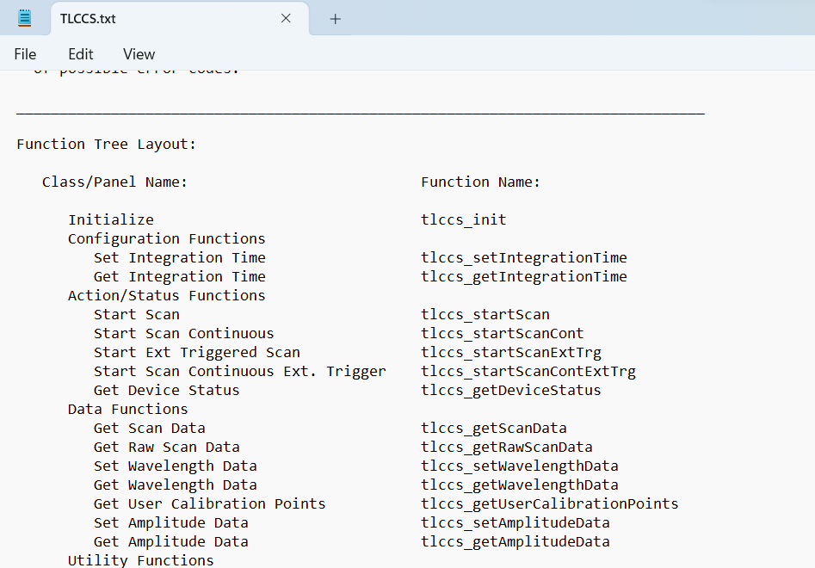
Phase I: Developing Thorlabs CCS
Purpose: Develop a code that can perform same functions with CCS as in-built software
Method: Use Software Development Kits(SDKs) to make fully functioning code
Live plot video
Data capturing after fixed time intervals
Use ThorCam to take in video feed
Thus we can now replace the software with the code
SDK Kit functions

Slide 9
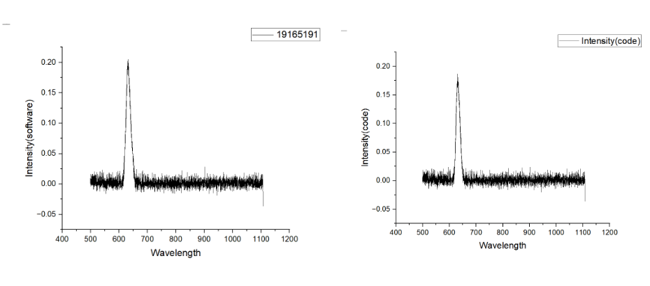
Phase I: Developing Thorlabs CCS
Data from the software
Data from the code

Slide 10

Phase I: Developing Thorlabs CCS

Slide 11
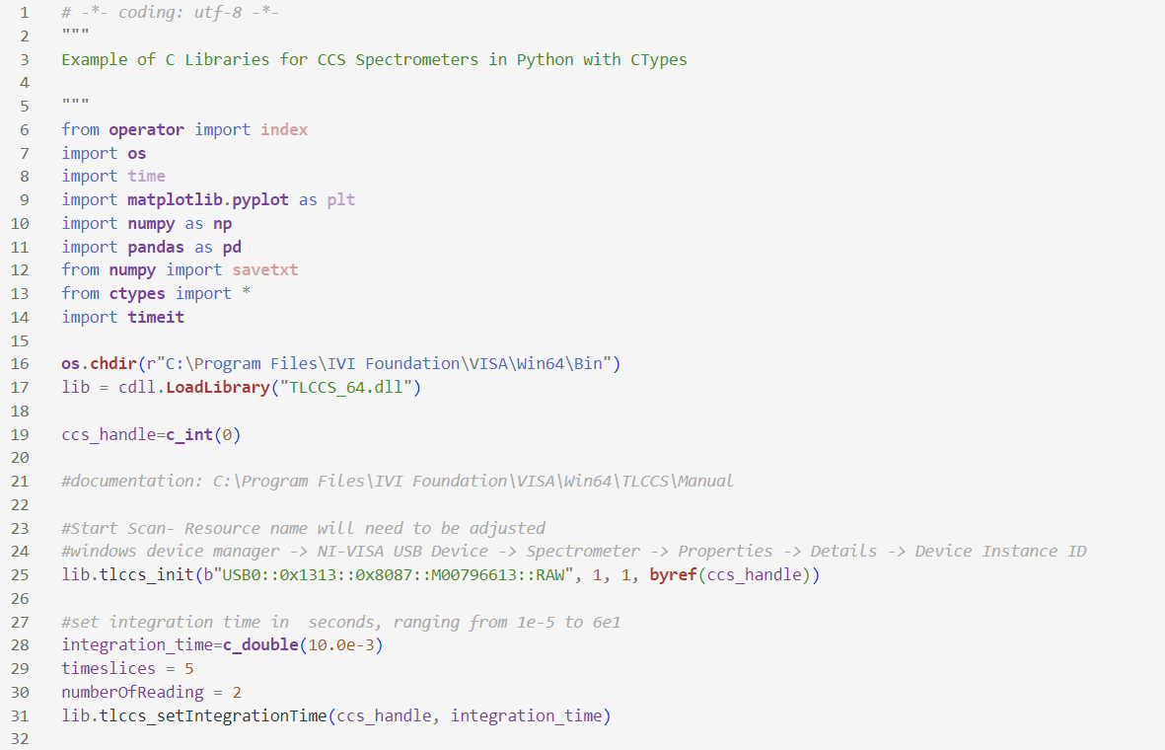
Phase I: Developing Thorlabs CCS
Import necessary modules
Connect to CCS by loading dll file
Set variables
Integration_time: time for which data collected

Slide 12
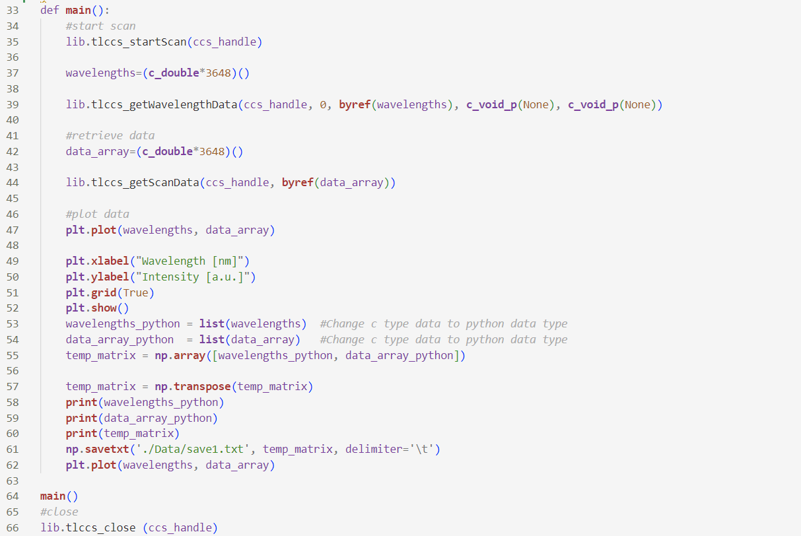
Phase I: Developing Thorlabs CCS
Collect Data
Plot data
Store Data

Slide 13
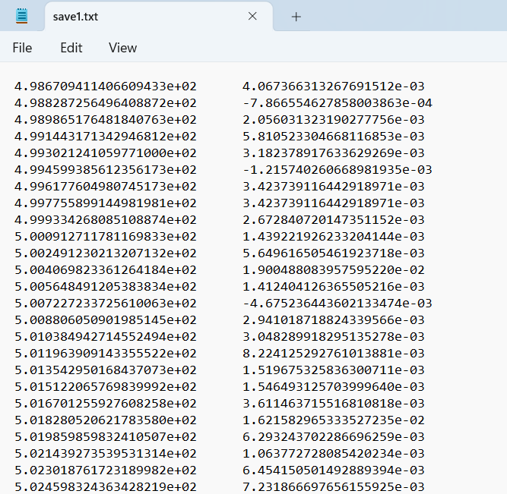
Phase I: Developing Thorlabs CCS
Wavelength vs intensity data for single point

Slide 14
3.
Phase II:
Development of Nanomax

Slide 15
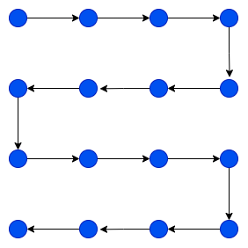
Phase II: Development of Nanomax
Purpose: Make the stage move across all points of interest
As mechanism is dependent on voltage values, input dependent on voltage values
We move in a snake-like pattern and collect data points in the same way.

Slide 16
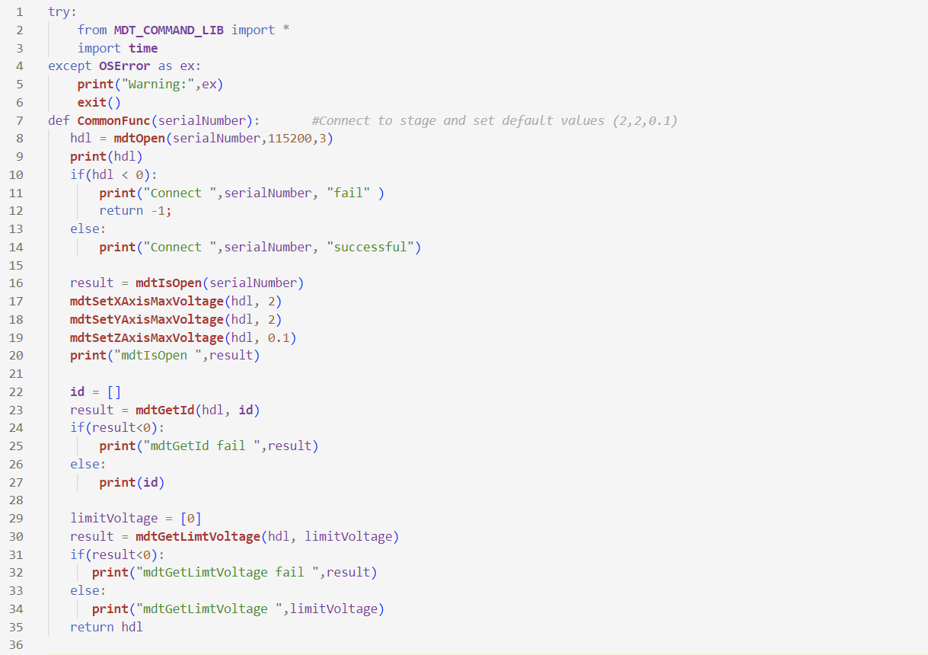
Phase II: Development of Nanomax
Using serialNumber connect to stage
Return the handle value

Slide 17
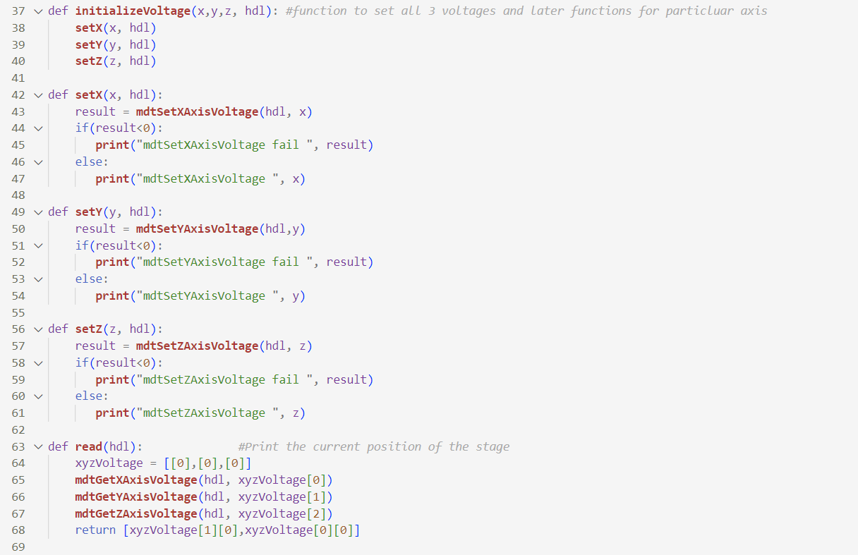
Phase II: Development of Nanomax
Set of functions defined to perform tasks

Slide 18
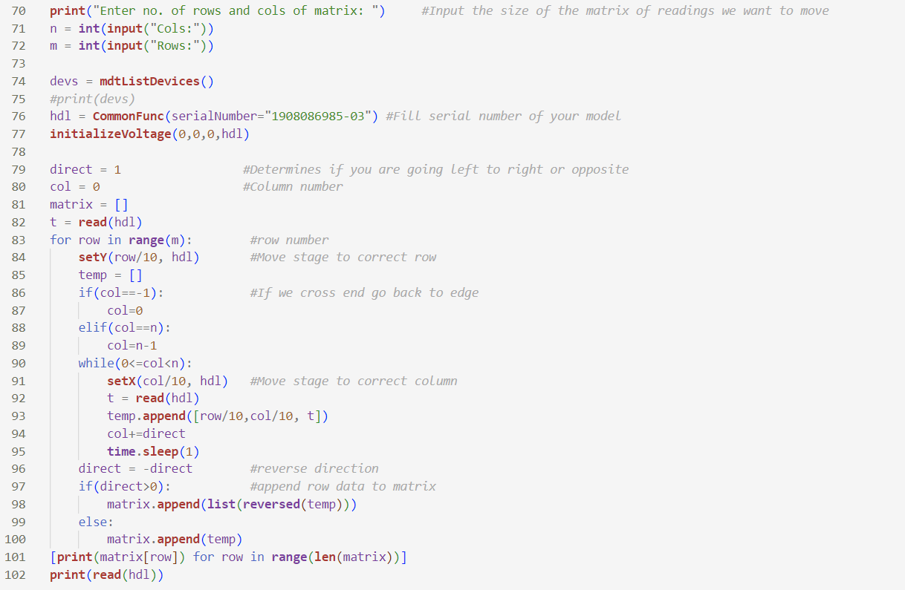
Phase II: Development of Nanomax
Initialize the stage
Loops control the motion of stage
Prints data of each location at each pount

Slide 19
4.
Phase II:
Integration of CCS & Nanomax

Slide 20
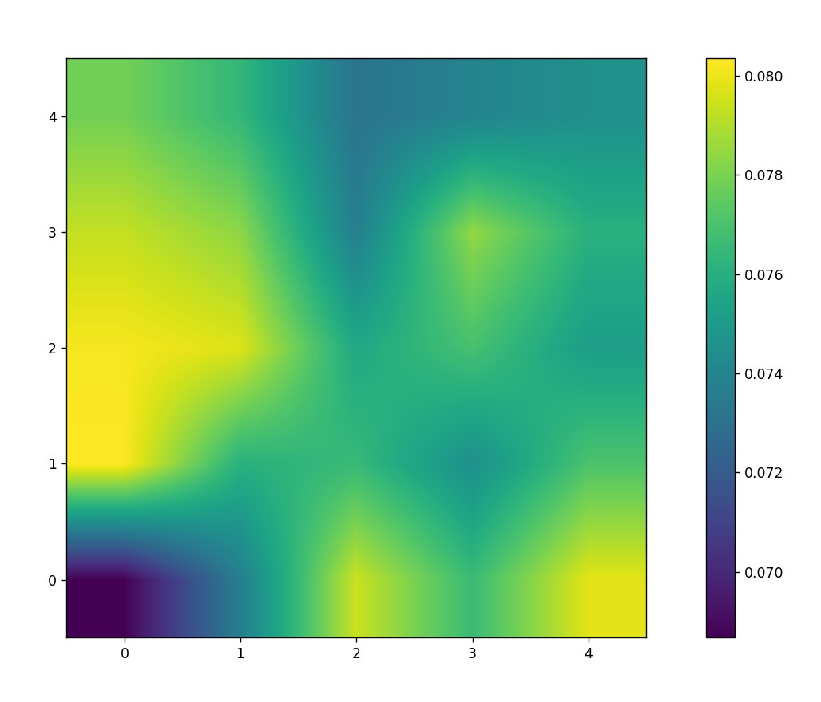
Phase III: Integration of CCS & Nanomax
Purpose: Develop a new code that would perform the task for us by integrating work of previous phases
Algorithm shall scan a region and collect data at each point in the matrix
Color Plot according to max intensity
Click to Scan
Data is stored and plot tells about structure of the space

Slide 21
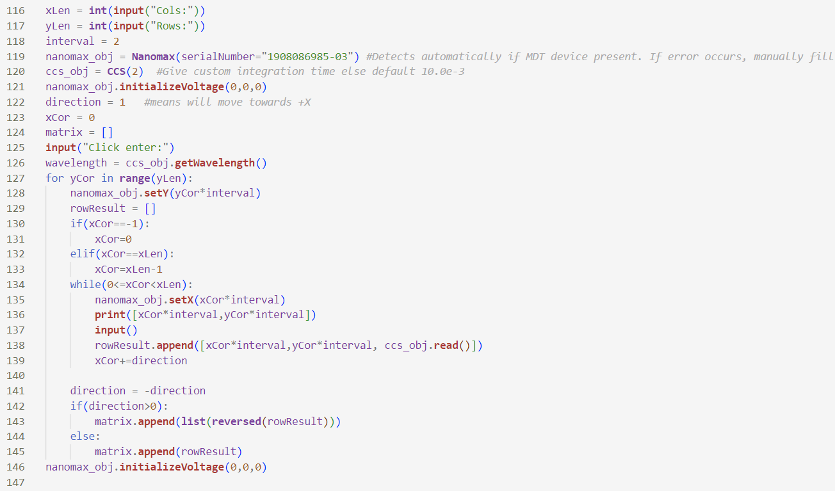
Phase III: Integration of CCS & Nanomax
Initialize CCS and Nanomax
Gather data at each point

Slide 22
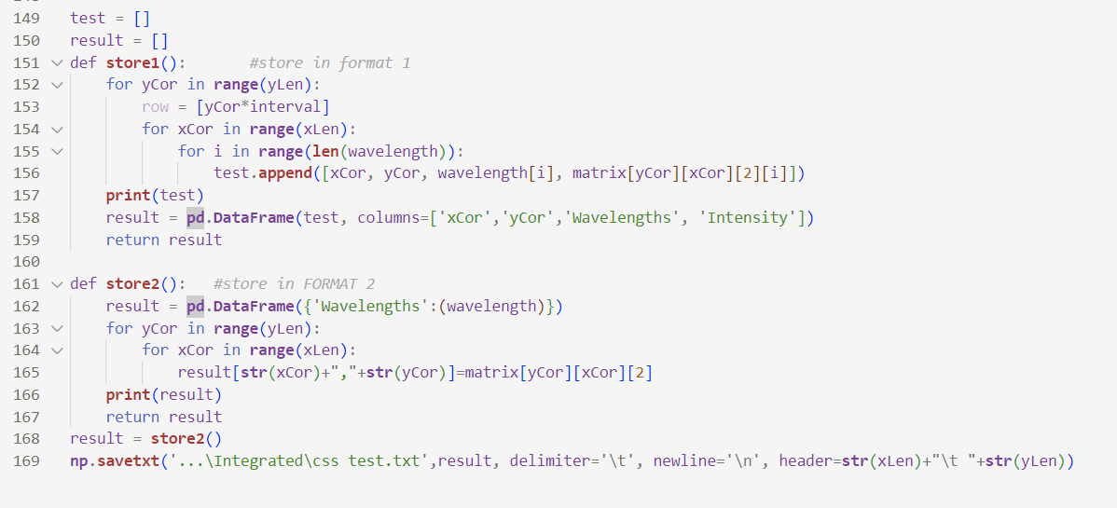
Phase III: Integration of CCS & Nanomax
Store data in two different formats as txt file

Slide 23
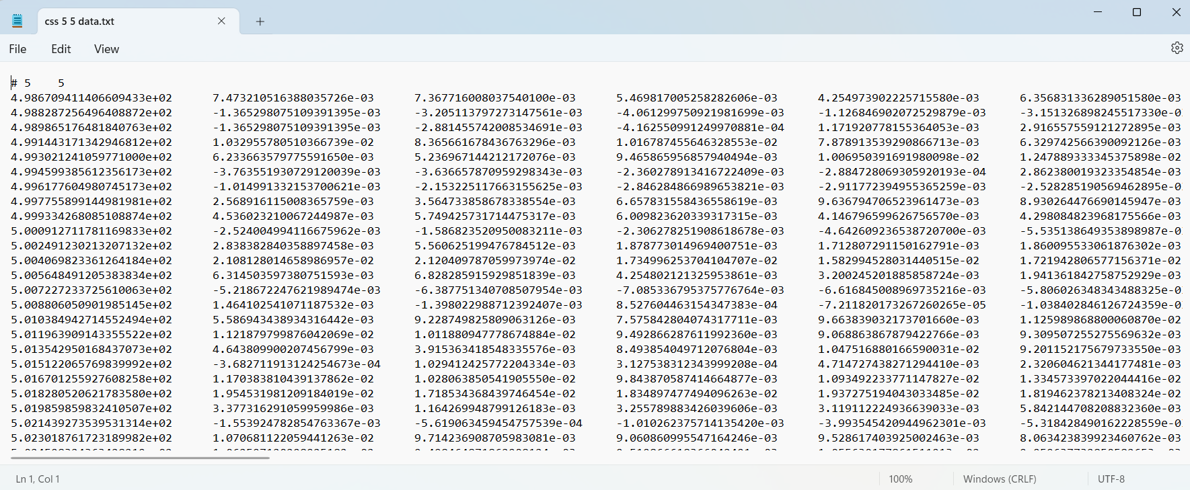
Phase III: Integration of CCS & Nanomax
Data stored in txt file

Slide 24
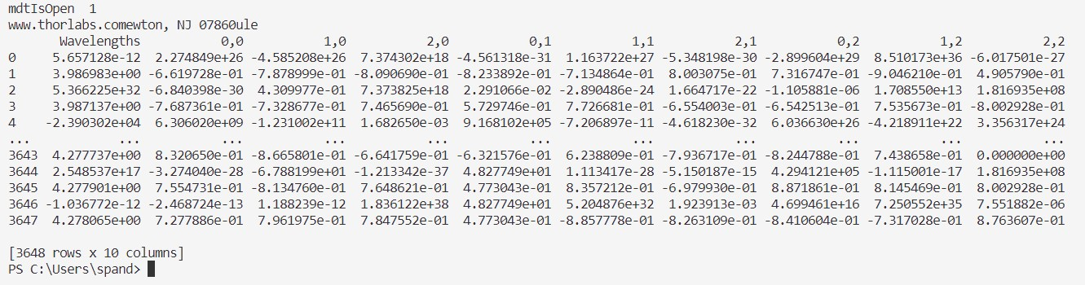
Phase III: Integration of CCS & Nanomax
Data stored in Pandas Dataframe

Slide 25
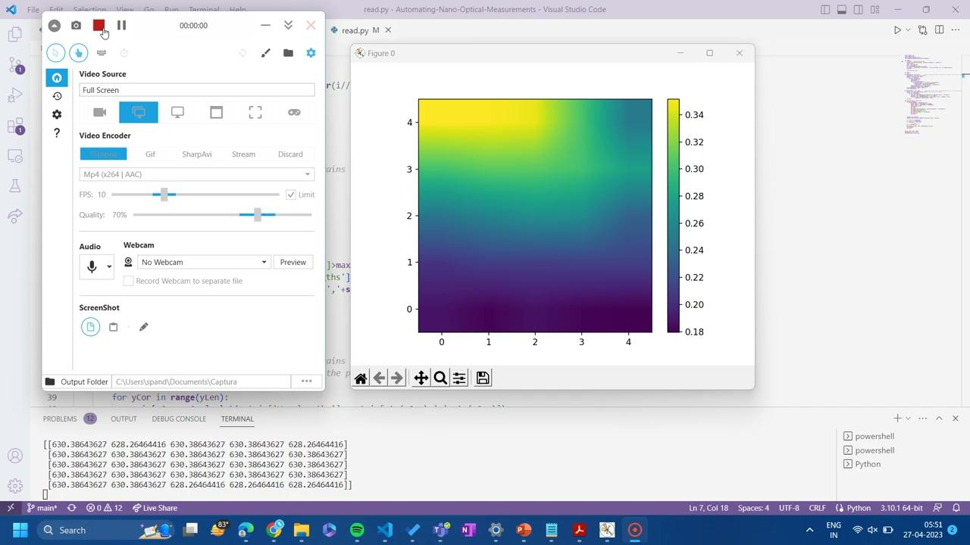
Phase III: Integration of CCS & Nanomax

Slide 26
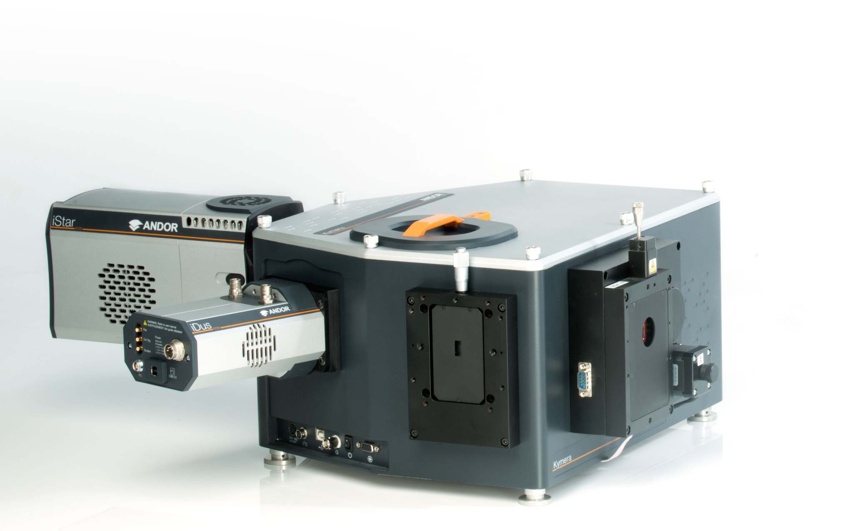
Conclusion
Thus we have completed the work on combination of CCS and Nanomax.
We are already equipped with a basic methodology to perform our experiment
However the spectrometer we are using though compact and low-cost is not enough to analyze the samples
As further work, we can now attempt to use the skeleton of these codes on an Andor Spectrometer + Nanomax combination
Andor has multiple gratings available for increased accuracy

